Slide 1

Database Systems:
Design, Implementation, and Management
12TH Edition
Chapter 3
The Relational Database Model

Slide 2
Data Modeling and Data Models
Data models
  Relatively simple representations of complex real-world data structures
    Often graphical
Model: an abstraction of a real-world object or event
  Useful in understanding complexities of the real-world environment
Data modeling is iterative and progressive
Database Systems, 10th Edition

Slide 3
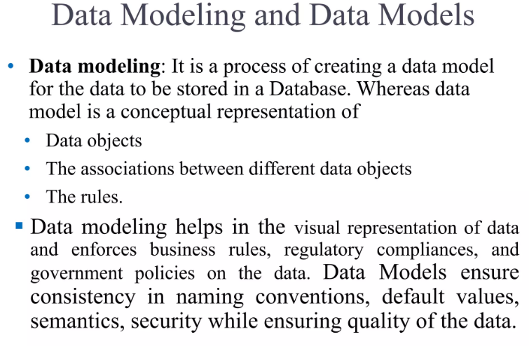

Database Systems, 10th Edition

Slide 4
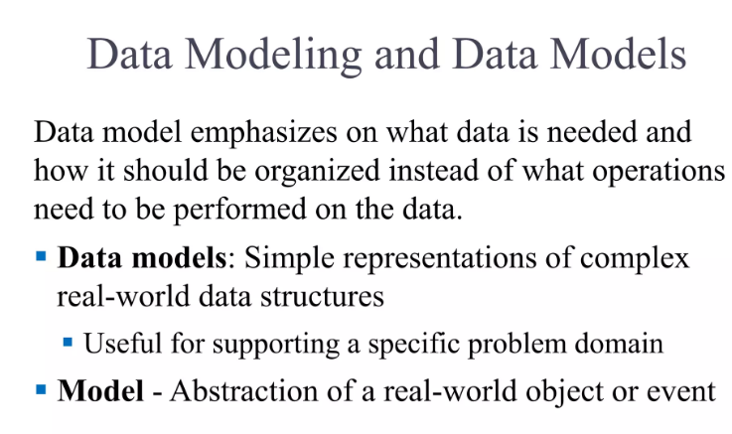
Database Systems, 10th Edition

Slide 5
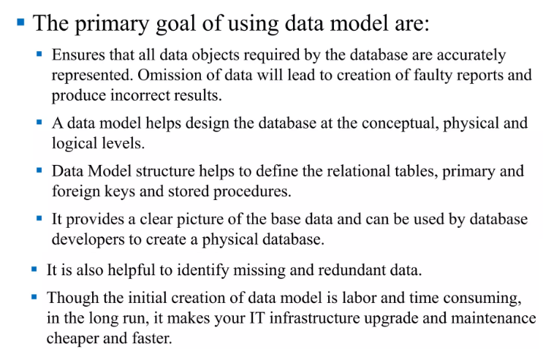
Database Systems, 10th Edition

Slide 6
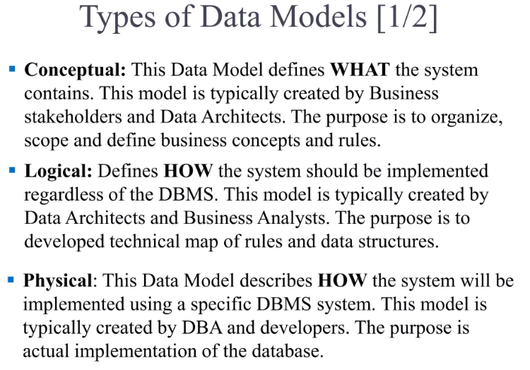
Database Systems, 10th Edition

Slide 7
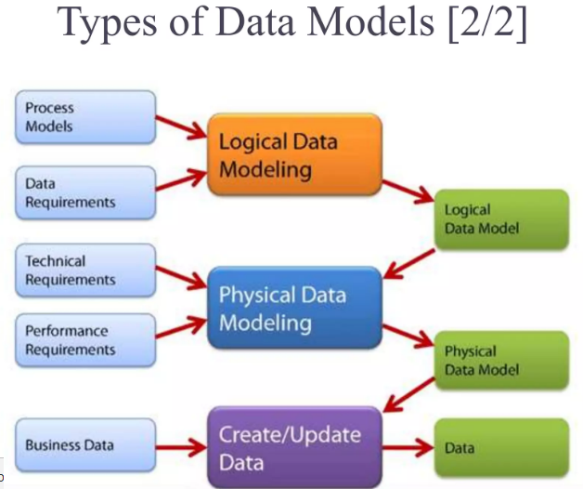
Database Systems, 10th Edition

Slide 8
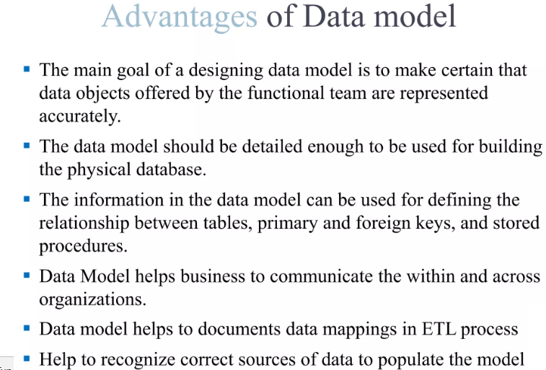
Database Systems, 10th Edition

Slide 9
The Importance of Data Models
Facilitate interaction among the designer, the applications programmer, and the end user
End users have different views and needs for data
Data model organizes data for various users
Data model is an abstraction
  Cannot draw required data out of the data model
Database Systems, 10th Edition

Slide 10
Data Model Basic Building Blocks
Entity: anything about which data are to be collected and stored
Attribute: a characteristic of an entity
Relationship: describes an association among entities
  One-to-many (1:M) relationship
  Many-to-many (M:N or M:M) relationship
  One-to-one (1:1) relationship
Constraint: a restriction placed on the data
Database Systems, 10th Edition

Slide 11
Business Rules
Descriptions of policies, procedures, or principles within a specific organization
  Apply to any organization that stores and uses data to generate information
Description of operations to create/enforce actions within an organization’s environment
  Must be in writing and kept up to date
  Must be easy to understand and widely disseminated
Describe characteristics of data as viewed by the company
Database Systems, 10th Edition

Slide 12
Discovering Business Rules (cont’d.)
Standardize company’s view of data
Communications tool between users and designers
Allow designer to understand the nature, role, and scope of data
Allow designer to understand business processes
Allow designer to develop appropriate relationship participation rules and constraints
Database Systems, 10th Edition

Slide 13
Translating Business Rules into Data Model Components
Nouns translate into entities
Verbs translate into relationships among entities
Relationships are bidirectional
Two questions to identify the relationship type:
  How many instances of B are related to one instance of A?
  How many instances of A are related to one instance of B?
Database Systems, 10th Edition

Slide 14
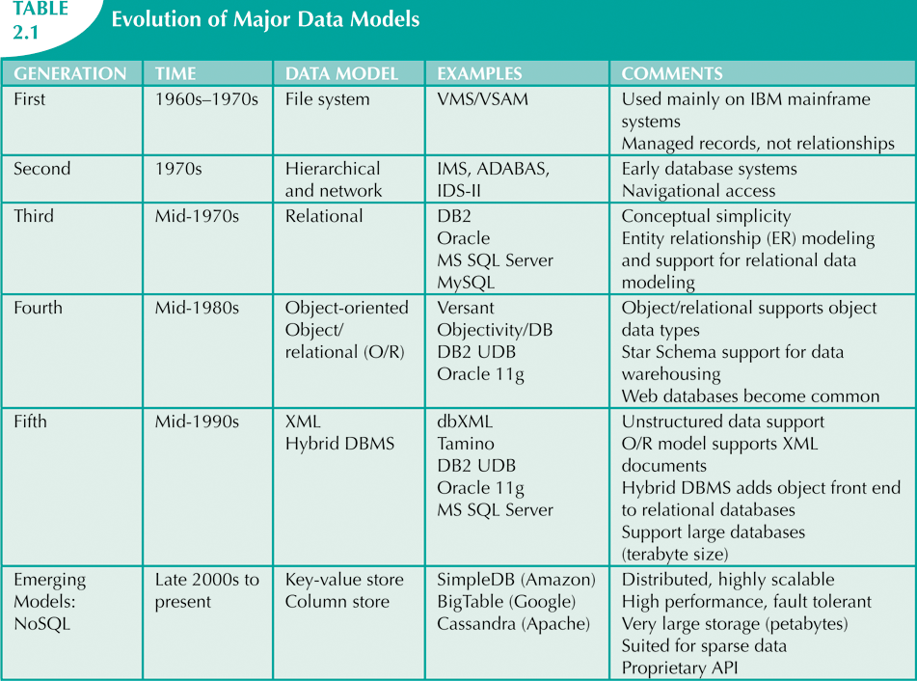
The Evolution of Data Models
Database Systems, 10th Edition

Slide 15
The Relational Model
Developed by E.F. Codd (IBM) in 1970
Table (relations)
  Matrix consisting of row/column intersections
  Each row in a relation is called a tuple
Relational models were considered impractical in 1970
Model was conceptually simple at expense of computer overhead
Database Systems, 10th Edition

Slide 16
The Relational Model (cont’d.)
Relational data management system (RDBMS)
  Performs same functions provided by hierarchical model
  Hides complexity from the user
Relational diagram
  Representation of entities, attributes, and relationships
Relational table stores collection of related entities
Database Systems, 10th Edition

Slide 17
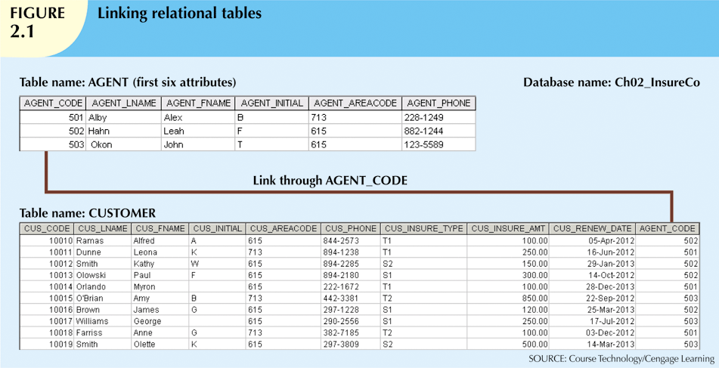
Database Systems, 10th Edition

Slide 18
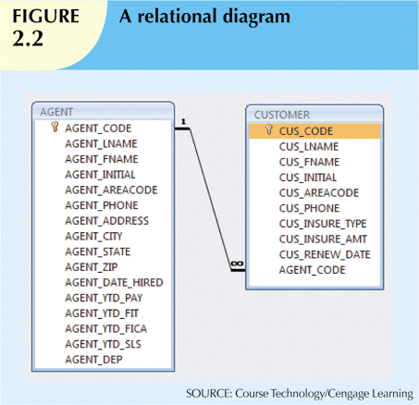
Database Systems, 10th Edition

Slide 19
A Logical View of Data
Relational model
  View data logically rather than physically
Table
  Structural and data independence
  Resembles a file conceptually
Relational database model is easier to understand than hierarchical and network models
Database Systems, 10th Edition

Slide 20
Tables and Their Characteristics
Logical view of relational database is based on relation
  Relation thought of as a table
Table: two-dimensional structure composed of rows and columns
  Persistent representation of logical relation
Contains group of related entities (entity set)
Database Systems, 10th Edition

Slide 21
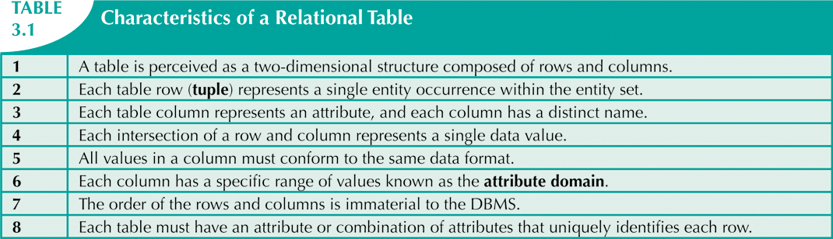
Database Systems, 10th Edition

Slide 22
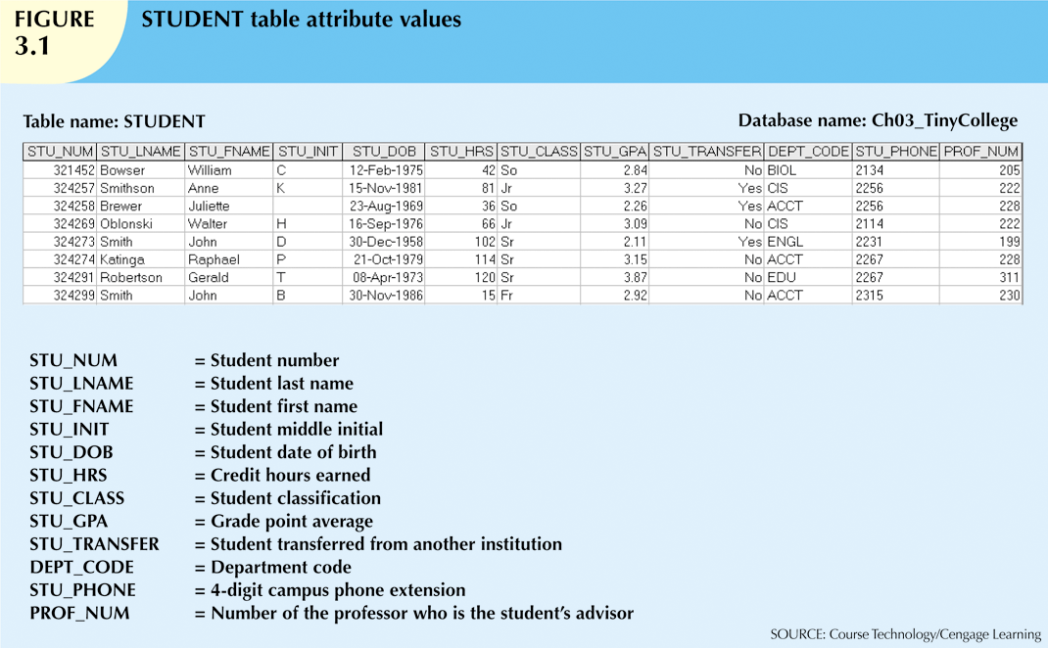
Database Systems, 10th Edition

Slide 23
Keys
Each row in a table must be uniquely identifiable
Key: one or more attributes that determine other attributes
  Key’s role is based on determination
    If you know the value of attribute A, you can determine the value of attribute B
  Functional dependence
    Attribute B is functionally dependent on A if all rows in table that agree in value for A also agree in value for B
Database Systems, 10th Edition

Slide 24
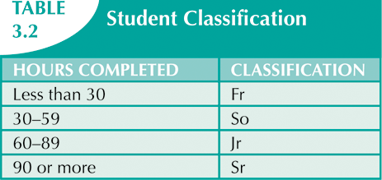
Database Systems, 10th Edition

Slide 25
Types of Keys
Composite key
  Composed of more than one attribute
Key attribute
  Any attribute that is part of a key
Superkey
  Any key that uniquely identifies each row
Candidate key
  A superkey without unnecessary attributes
Database Systems, 10th Edition

Slide 26
Types of Keys (cont’d.)
Entity integrity
  Each row (entity instance) in the table has its own unique identity
Nulls
  No data entry
  Not permitted in primary key
  Should be avoided in other attributes
Database Systems, 10th Edition

Slide 27
Types of Keys (cont’d.)
  Can represent:
    An unknown attribute value
    A known, but missing, attribute value
    A “not applicable” condition
  Can create problems when functions such as COUNT, AVERAGE, and SUM are used
  Can create logical problems when relational tables are linked
Database Systems, 10th Edition

Slide 28
Types of Keys (cont’d.)
Controlled redundancy
  Makes the relational database work
  Tables within the database share common attributes
    Enables tables to be linked together
  Multiple occurrences of values not redundant when required to make the relationship work
  Redundancy exists only when there is unnecessary duplication of attribute values
Database Systems, 10th Edition

Slide 29
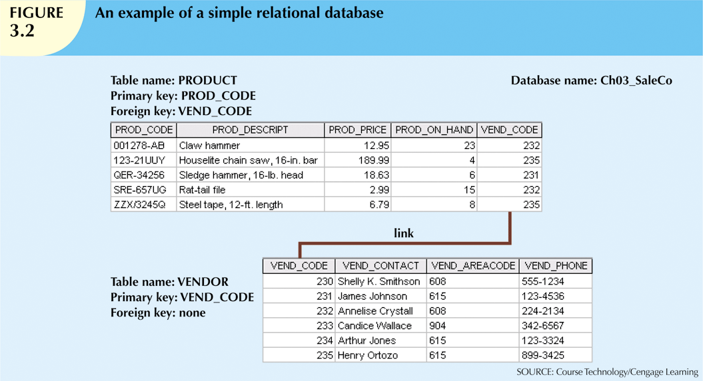
Database Systems, 10th Edition

Slide 30
Types of Keys (cont’d.)
Foreign key (FK)
  An attribute whose values match primary key values in the related table
Referential integrity
  FK contains a value that refers to an existing valid tuple (row) in another relation
Secondary key
  Key used strictly for data retrieval purposes
Database Systems, 10th Edition

Slide 31
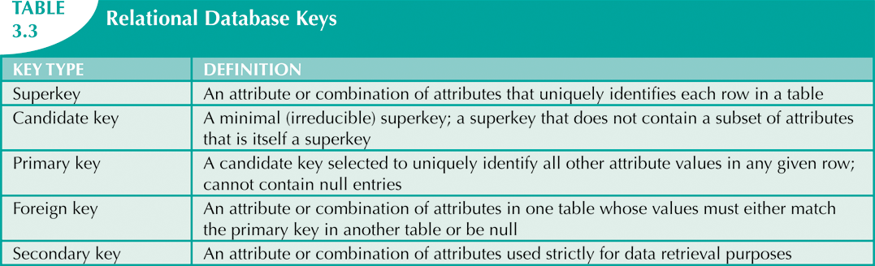
Database Systems, 10th Edition

Slide 32
Integrity Rules
Many RDBMs enforce integrity rules automatically
Safer to ensure that application design conforms to entity and referential integrity rules
Designers use flags to avoid nulls
  Flags indicate absence of some value
Database Systems, 10th Edition

Slide 33
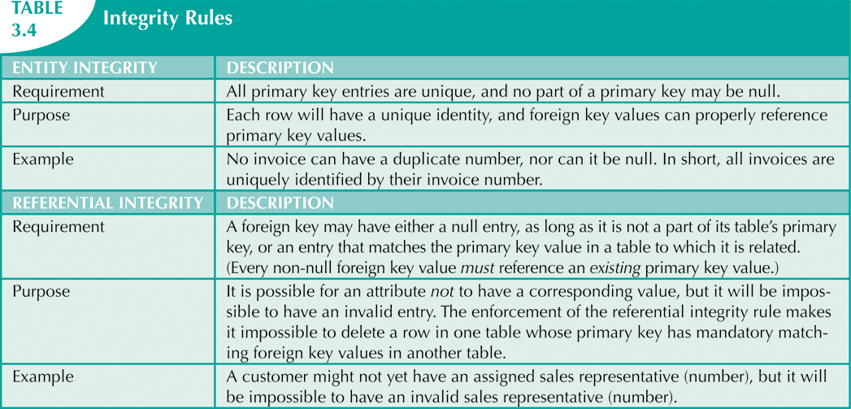

Database Systems, 10th Edition

Slide 34
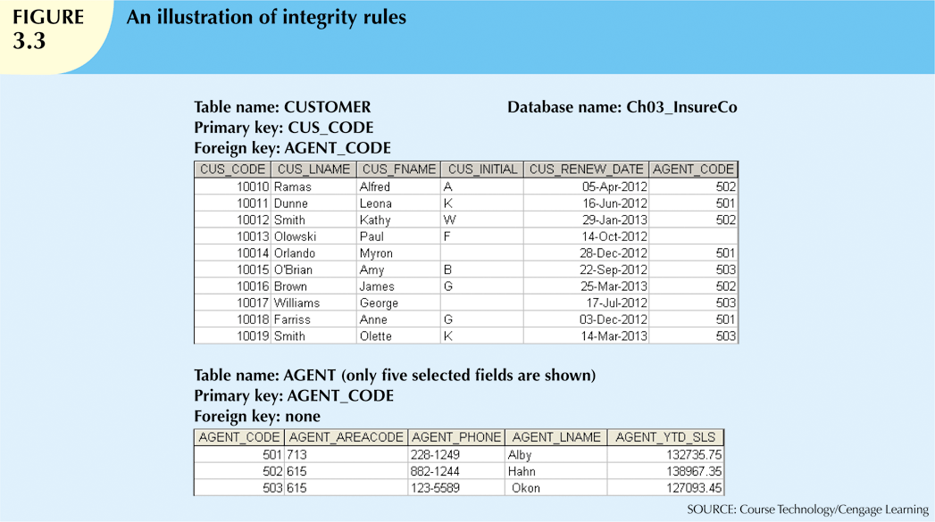
Database Systems, 10th Edition

Slide 35
Lecture 4
Relational Operators
Chapter 3
The Relational Database Model

Slide 36
Relational Set Operators
Relational algebra
  Defines theoretical way of manipulating table contents using relational operators
  Use of relational algebra operators on existing relations produces new relations:
SELECT | UNION
PROJECT | DIFFERENCE
JOIN | PRODUCT
INTERSECT | DIVIDE
Database Systems, 10th Edition

Slide 37
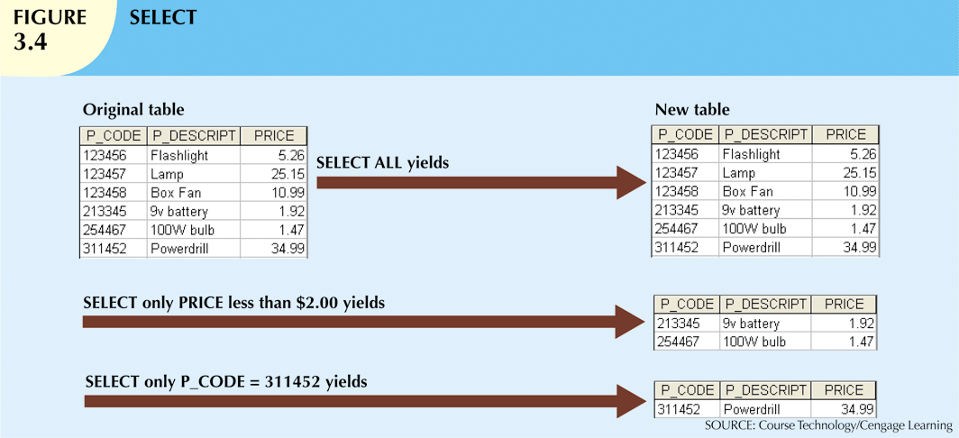
Database Systems, 10th Edition

Slide 38
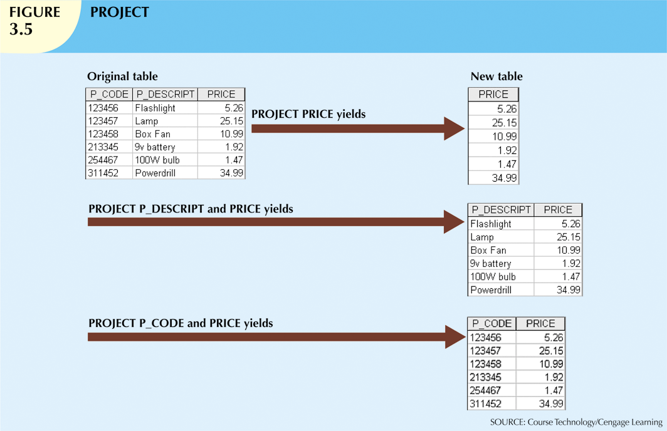
Database Systems, 10th Edition

Slide 39
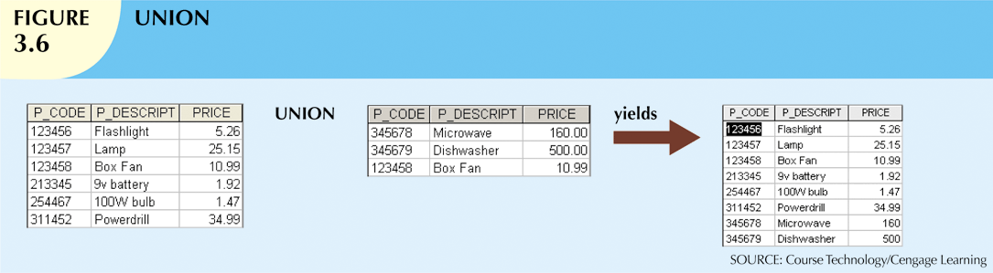
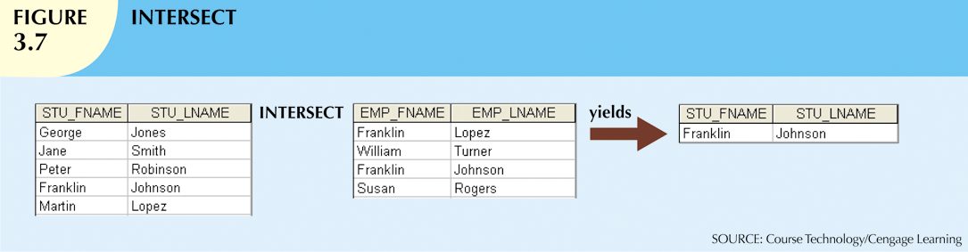
Database Systems, 10th Edition

Slide 40
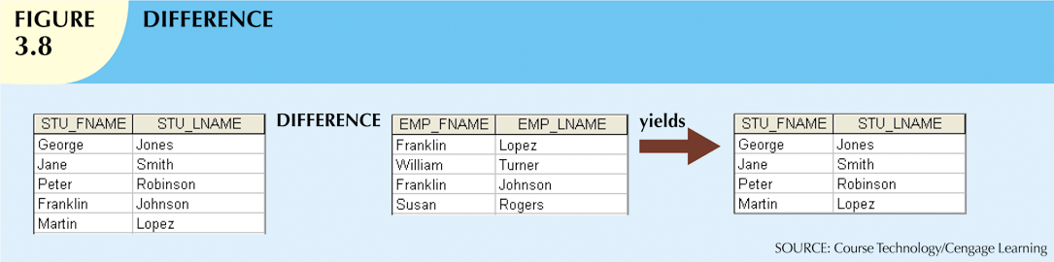
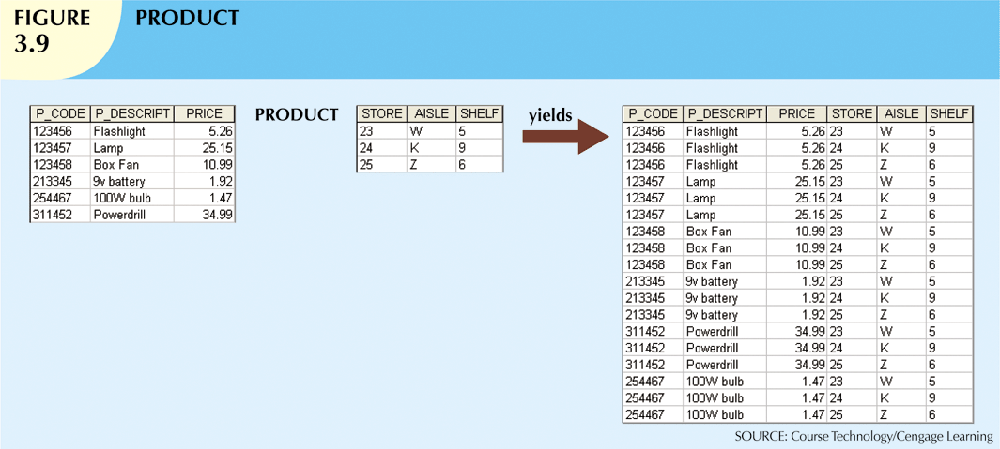
Database Systems, 10th Edition

Slide 41
Relational Set Operators (cont’d.)
Natural join
  Links tables by selecting rows with common values in common attributes (join columns)
Equijoin
  Links tables on the basis of an equality condition that compares specified columns
Theta join
  Any other comparison operator is used
Database Systems, 10th Edition

Slide 42
Relational Set Operators (cont’d.)
Inner join
  Only returns matched records from the tables that are being joined
Outer join
  Matched pairs are retained, and any unmatched values in other table are left null
Database Systems, 10th Edition

Slide 43
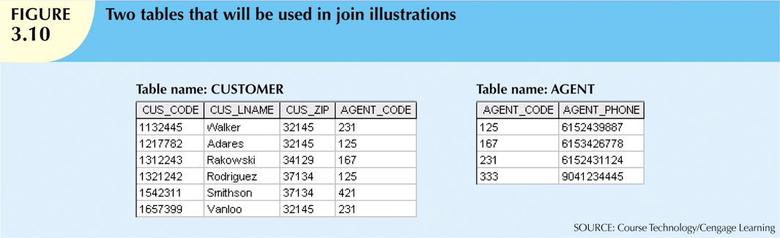
Database Systems, 10th Edition

Slide 44
Relational Set Operators (cont’d.)
Left outer join
  Yields all of the rows in the CUSTOMER table
  Including those that do not have a matching value in the AGENT table
Right outer join
  Yields all of the rows in the AGENT table
  Including those that do not have matching values in the CUSTOMER table
Database Systems, 10th Edition

Slide 45
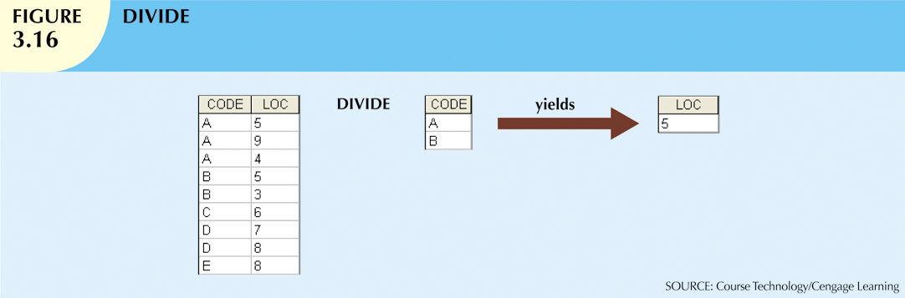
Database Systems, 10th Edition

Slide 46
Lecture 6
Relational Model (Relationships) and Degree of abstraction
Chapter 3
The Relational Database Model

Slide 47
The Data Dictionary and System Catalog
Data dictionary
  Provides detailed accounting of all tables found within the user/designer-created database
  Contains (at least) all the attribute names and characteristics for each table in the system
  Contains metadata: data about data
System catalog
  Contains metadata
  Detailed system data dictionary that describes all objects within the database
Database Systems, 10th Edition

Slide 48
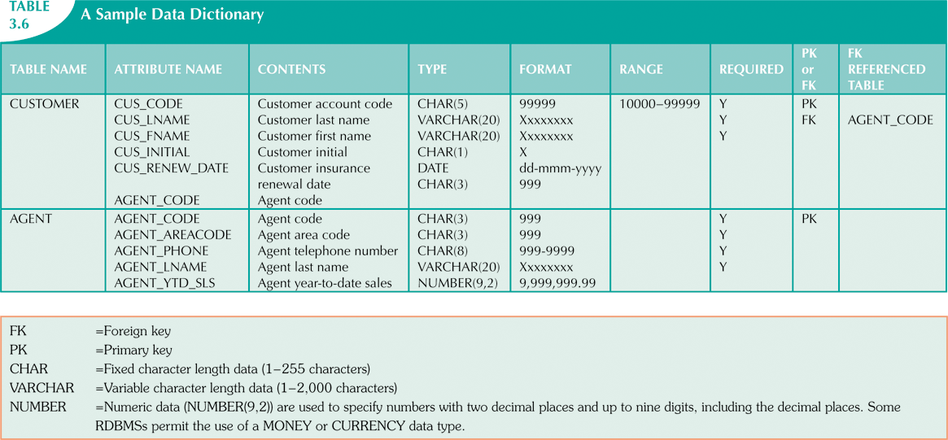
Database Systems, 10th Edition

Slide 49
The Data Dictionary and System Catalog (cont’d.)
Homonym
  Indicates the use of the same name to label different attributes
Synonym
  Opposite of a homonym
  Indicates the use of different names to describe the same attribute
Database Systems, 10th Edition

Slide 50
Relationships within the Relational Database
1:M relationship
  Relational modeling ideal
  Should be the norm in any relational database design
1:1 relationship
  Should be rare in any relational database design
Database Systems, 10th Edition

Slide 51
Relationships within the Relational Database (cont’d.)
M:N relationships
  Cannot be implemented as such in the relational model
  M:N relationships can be changed into 1:M relationships
Database Systems, 10th Edition

Slide 52
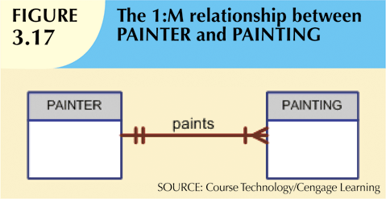
The 1:M Relationship
Relational database norm
Found in any database environment
Database Systems, 10th Edition

Slide 53
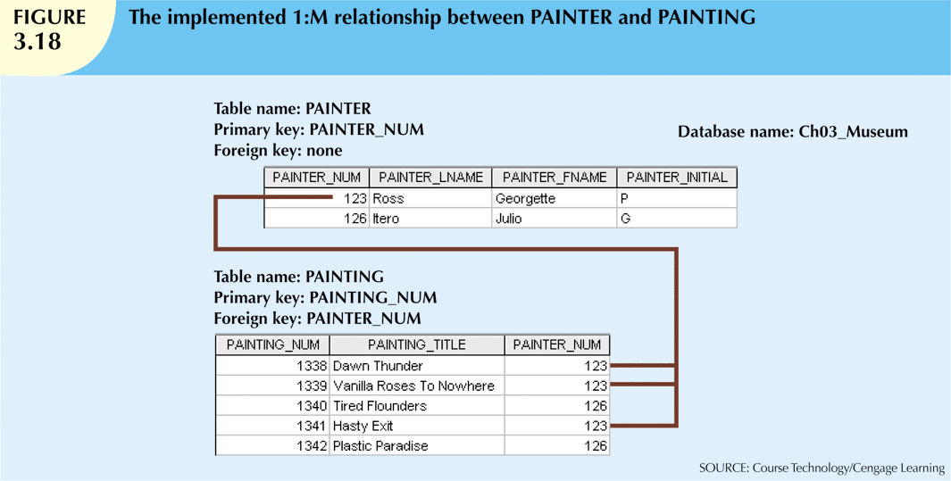
Database Systems, 10th Edition

Slide 54
The 1:1 Relationship
One entity related to only one other entity, and vice versa
Sometimes means that entity components were not defined properly
Could indicate that two entities actually belong in the same table
Certain conditions absolutely require their use
Database Systems, 10th Edition

Slide 55
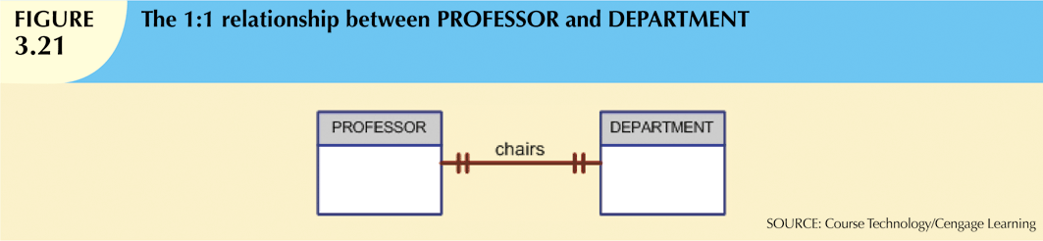
Database Systems, 10th Edition

Slide 56
The M:N Relationship
Implemented by breaking it up to produce a set of 1:M relationships
Avoid problems inherent to M:N relationship by creating a composite entity
  Includes as foreign keys the primary keys of tables to be linked
Database Systems, 10th Edition

Slide 57
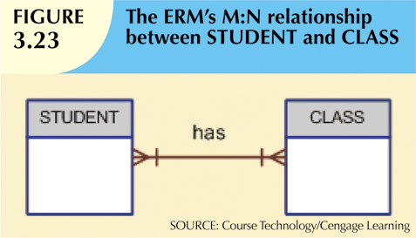
Database Systems, 10th Edition

Slide 58
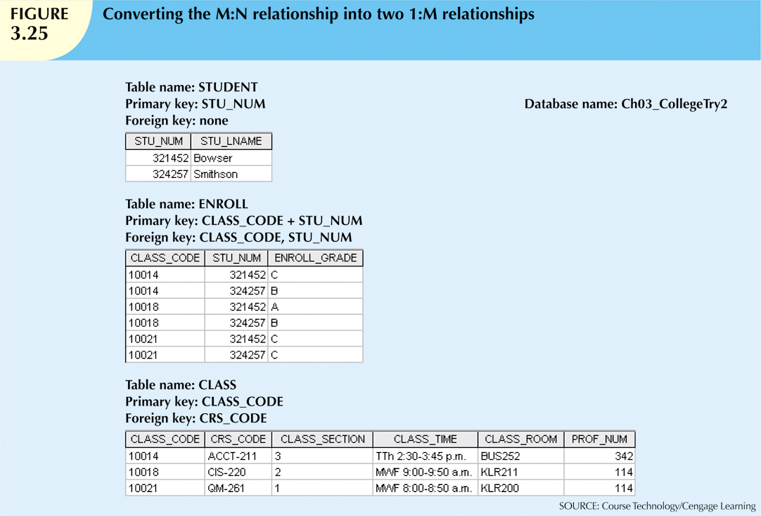
Database Systems, 10th Edition

Slide 59

Database Systems, 10th Edition

Slide 60
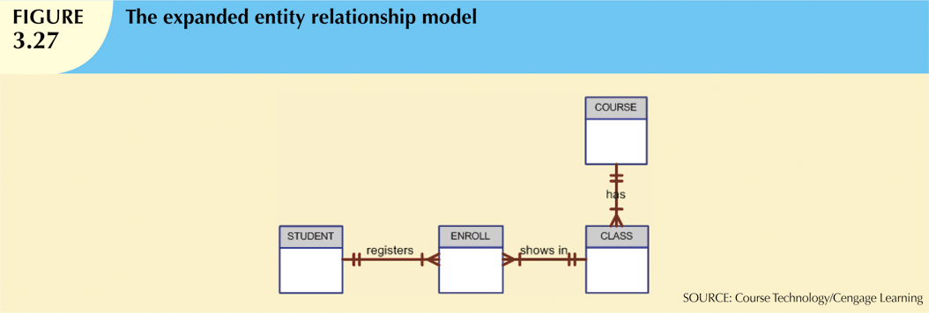
Database Systems, 10th Edition

Slide 61
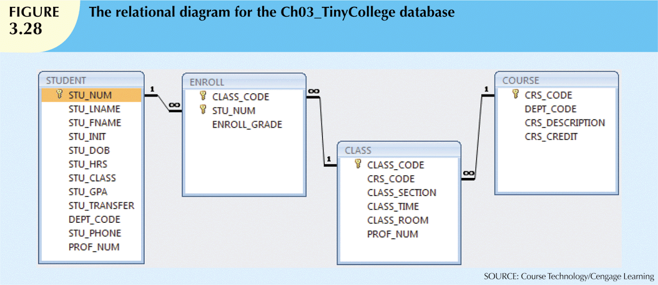
Database Systems, 10th Edition

Slide 62
Data Redundancy Revisited
Data redundancy leads to data anomalies
  Can destroy the effectiveness of the database
Foreign keys
  Control data redundancies by using common attributes shared by tables
  Crucial to exercising data redundancy control
Sometimes, data redundancy is necessary
Database Systems, 10th Edition

Slide 63
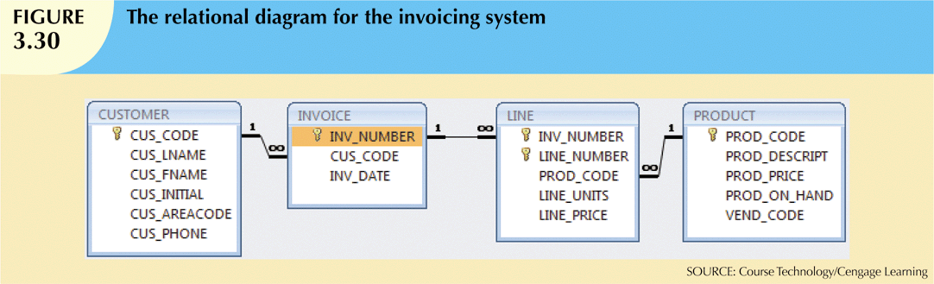
Database Systems, 10th Edition

Slide 64
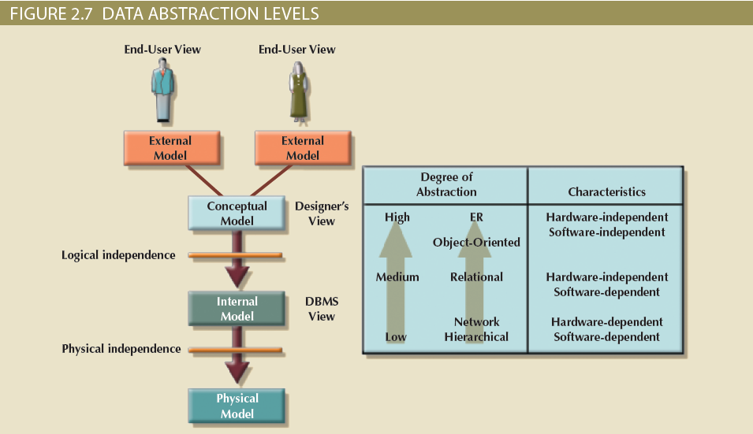

Data Abstraction Levels

Slide 65
The External Model
End users’ view of the data environment
ER diagrams are used to represent the external views
External schema: Specific representation of an external view

Slide 66
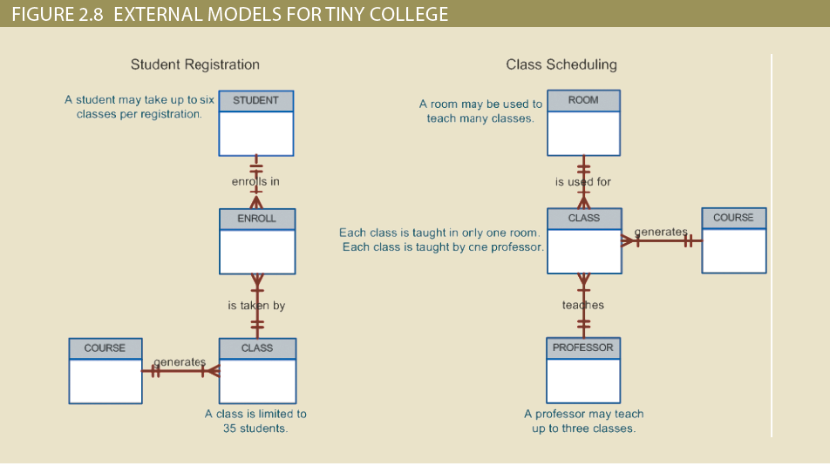
External Models For Tiny College

Slide 67
The Conceptual Model
Represents a global view of the entire database by the entire organization
Conceptual schema: Basis for the identification and high-level description of the main data objects
Has a macro-level view of data environment
Is software and hardware independent
Logical design: Task of creating a conceptual data model

Slide 68
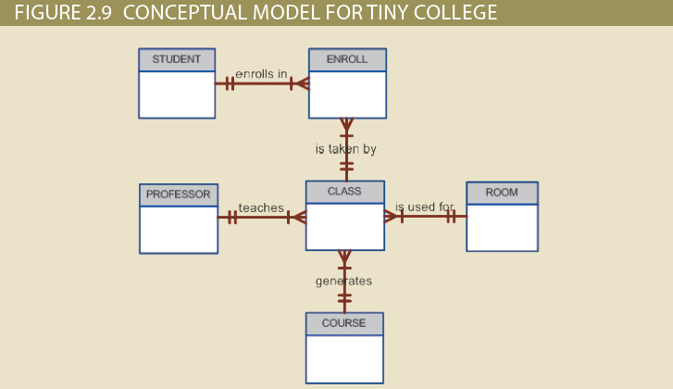
Conceptual Model For Tiny College

Slide 69
The Internal Model
Representing database as seen by the DBMS mapping conceptual model to the DBMS
Internal schema: Specific representation of an internal model
  Uses the database constructs supported by the chosen database
Is software dependent and hardware independent
Logical independence: Changing internal model without affecting the conceptual model

Slide 70
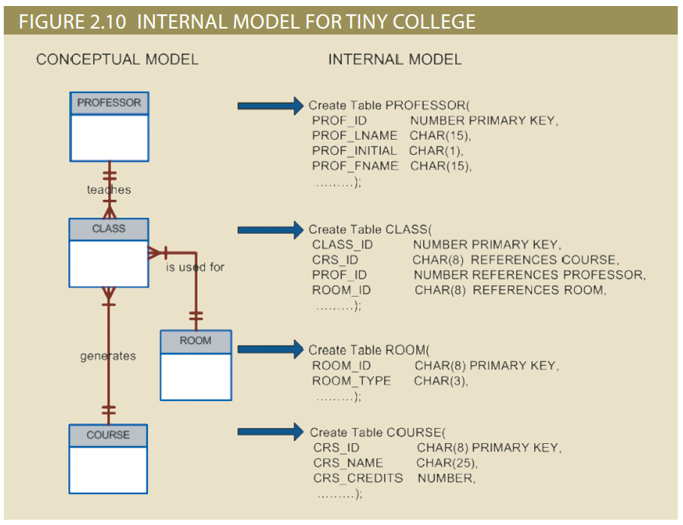
Internal Model for Tiny College

Slide 71
The Physical Model
Operates at lowest level of abstraction
Describes the way data are saved on storage media such as disks or tapes
Requires the definition of physical storage and data access methods
Relational model aimed at logical level
  Does not require physical-level details
Physical independence: Changes in physical model do not affect internal model

Slide 72
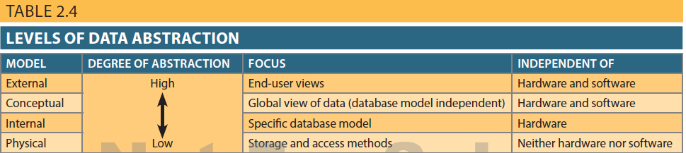
Table 2.4 - Levels of Data Abstraction

Slide 73
Codd’s Relational Database Rules
In 1985, Codd published a list of 12 rules to define a relational database system
  Products marketed as “relational” that did not meet minimum relational standards
Even dominant database vendors do not fully support all 12 rules
Database Systems, 10th Edition

Slide 74
Summary
Tables are basic building blocks of a relational database
Keys are central to the use of relational tables
Keys define functional dependencies
  Superkey
  Candidate key
  Primary key
  Secondary key
  Foreign key
Database Systems, 10th Edition

Slide 75
Summary (cont’d.)
Each table row must have a primary key that uniquely identifies all attributes
Tables are linked by common attributes
The relational model supports relational algebra functions
  SELECT, PROJECT, JOIN, INTERSECT UNION, DIFFERENCE, PRODUCT, DIVIDE
Good design begins by identifying entities, attributes, and relationships
  1:1, 1:M, M:N
Database Systems, 10th Edition

